Slide 1
Nominal Response Model

Slide 2
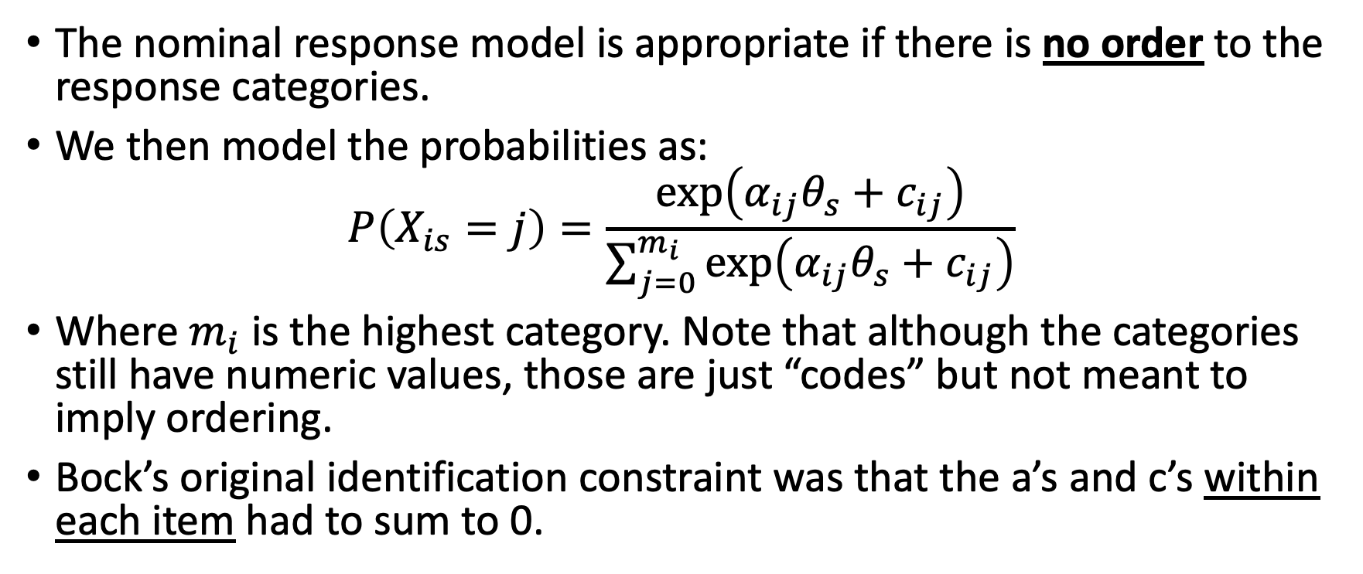
Original Nominal Response Model (NRM) Equation (Bock, 1972)
The nominal response model is appropriate if there is no order to the response categories.
We then model the probabilities as:
$$P\left(X_{is}=j\right)=\frac{\exp\left(α_{ij}θ_{s}+c_{ij}\right)}{\sum_{j=0}^{m_{i}}{\exp\left(α_{ij}θ_{s}+c_{ij}\right)}}$$
Where $m_{i}$ is the highest category. Note that although the categories still have numeric values, those are just “codes” but not meant to imply ordering.
Bock’s original identification constraint was that the a’s and c’s within each item had to sum to 0.

Slide 3
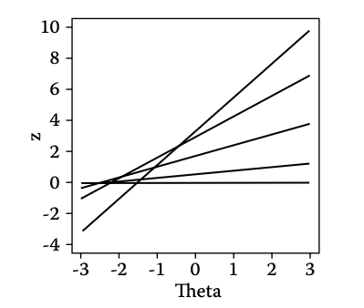
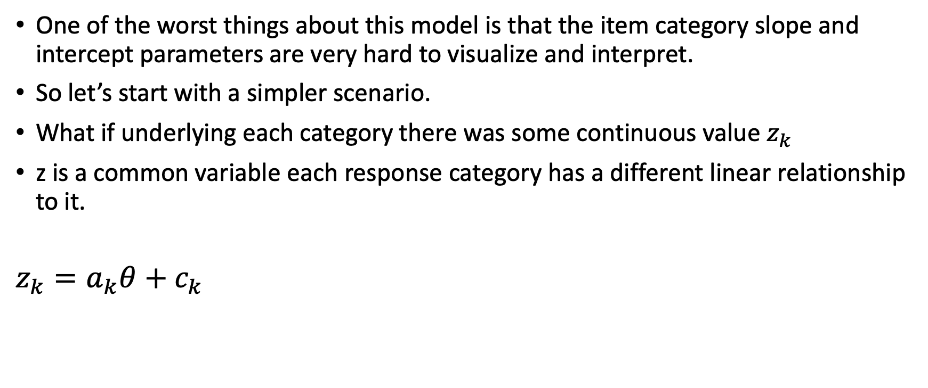
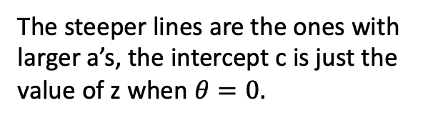
Interpretation of NRM Parameters
One of the worst things about this model is that the item category slope and intercept parameters are very hard to visualize and interpret.
So let’s start with a simpler scenario.
What if underlying each category there was some continuous value $z_{k}$
z is a common variable each response category has a different linear relationship to it.
$$z_{k}=a_{k}θ+c_{k}$$
The steeper lines are the ones with larger a’s, the intercept c is just the value of z when $θ=0.$

Slide 4
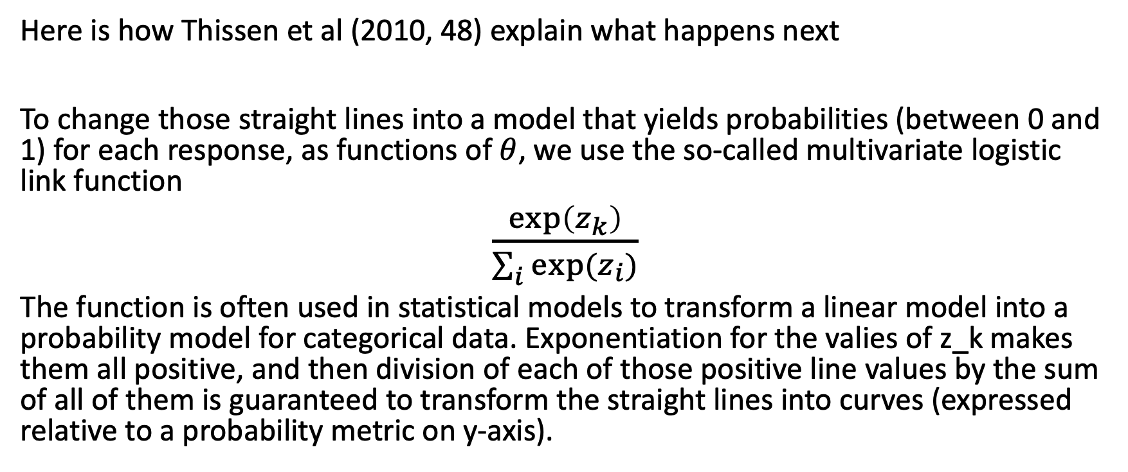
Multivariate link function
Here is how Thissen et al (2010, 48) explain what happens next
To change those straight lines into a model that yields probabilities (between 0 and 1) for each response, as functions of $θ$, we use the so-called multivariate logistic link function
$\frac{\exp\left(z_{k}\right)}{\sum_{i}{exp⁡(z_{i})}}$
The function is often used in statistical models to transform a linear model into a probability model for categorical data. Exponentiation for the valies of z_k makes them all positive, and then division of each of those positive line values by the sum of all of them is guaranteed to transform the straight lines into curves (expressed relative to a probability metric on y-axis).

Slide 5
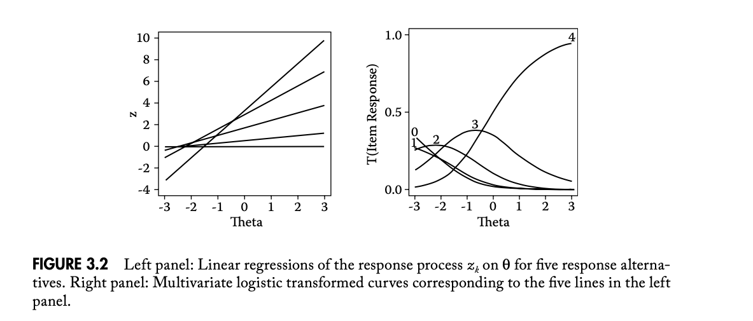
The new visualization
Here the a’s and c’s are easy to interpret
Here they are not!

Slide 6
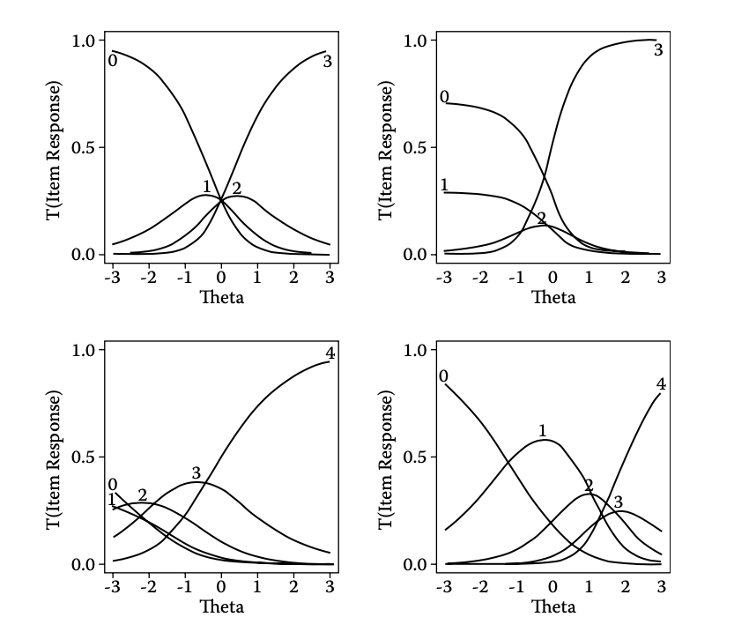
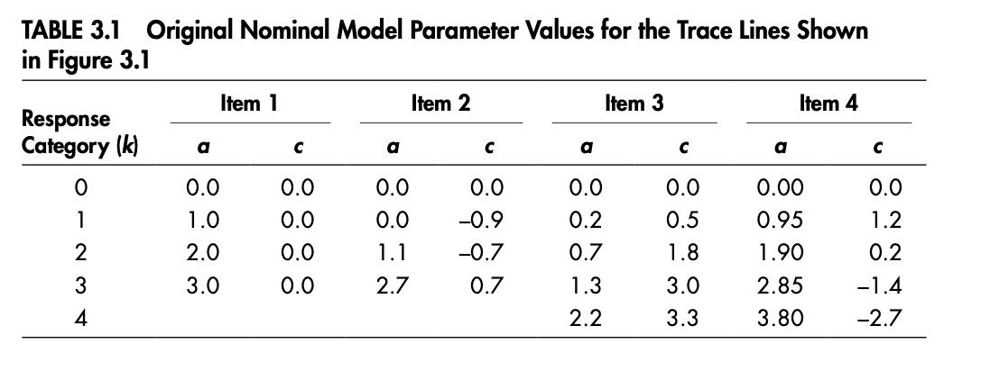
Some Helpful Examples
The only clear interpretation is that the order of the a’s tells you something about both the order and weight to be given in each category. The lowest/highest a values will be monotonically decreasing /increasing along theta. The categories with a’s in between will have curves with one one distinct peak. Location of peak can be predicted by order of the a’s.
Note that in this example the locations of the a’s and c’s are being identified by setting the lowest category a and c to be 0. (This is actually not what happens in mirt)

Slide 7
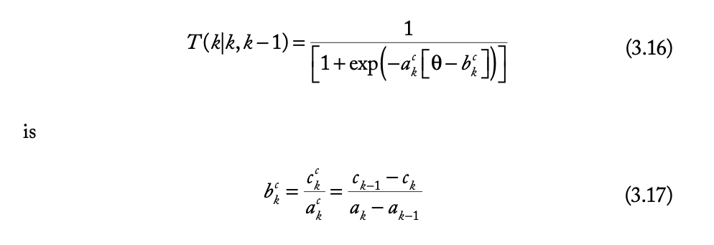
Expressing NRM parameters relative to adjacent categories.
One you have some idea for order based on a’s, with some work, you can re-express the a and c parameters in terms of the locations of Andrich thresholds and the discrimination at these thresholds.

Slide 8
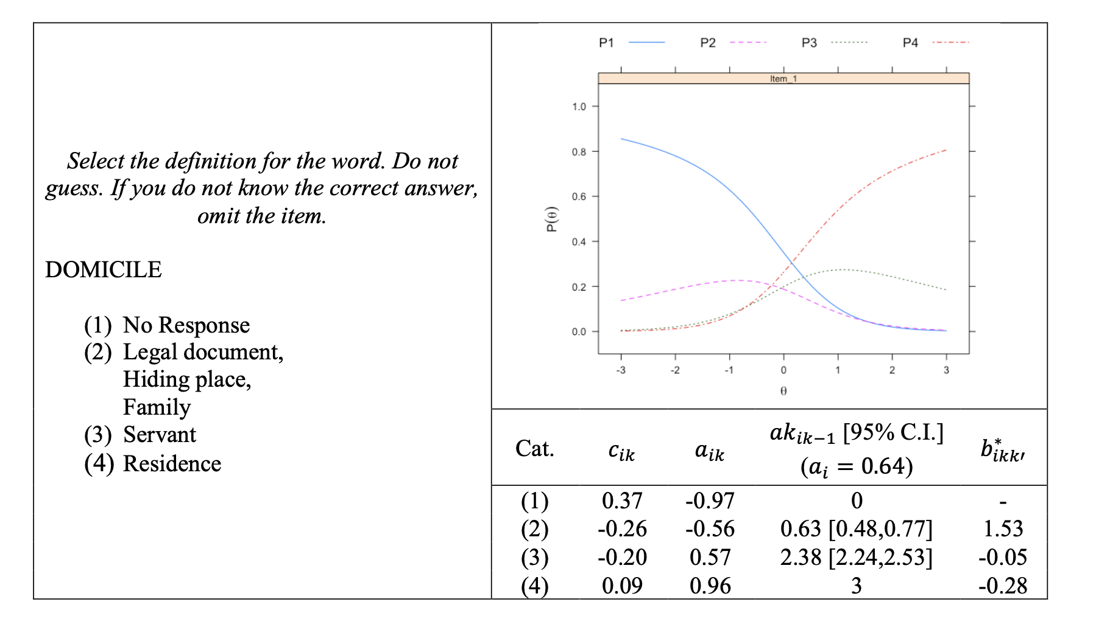
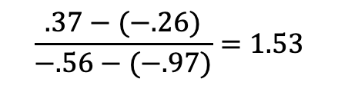
An Example Getting Andrich Parameters
$$\frac{.37−(−.26)}{−.56−(−.97)}=1.53$$
The location where a person has a 50% chance at responding in category 1 vs 2 is 1.53 logits

Slide 9
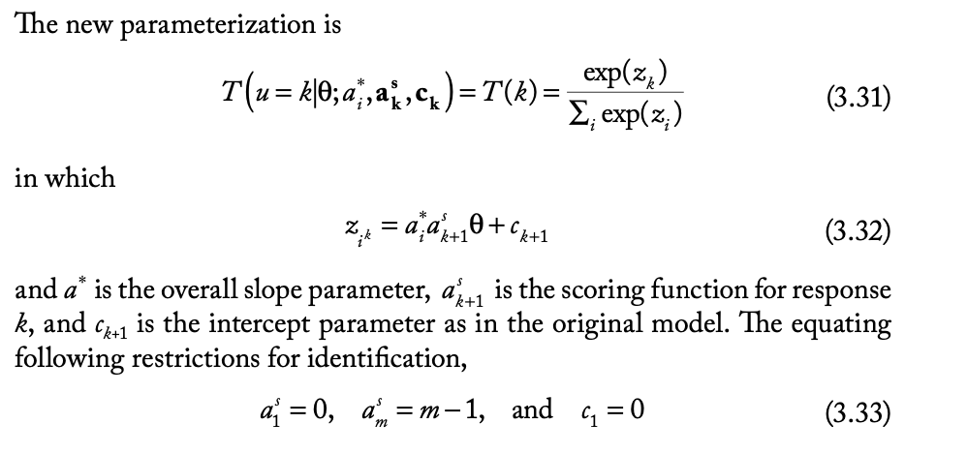
A New NRM Parameterization
This is the default parameterization for the nrm used in mirt. What it accomplishes is that it separates an overall discrimination for the item (a_i) from the empirically derived weights or scores to be assigned to each category (a_k+1). To do this, two categories have to be selected as highest and lowest scored in advance.

Slide 10
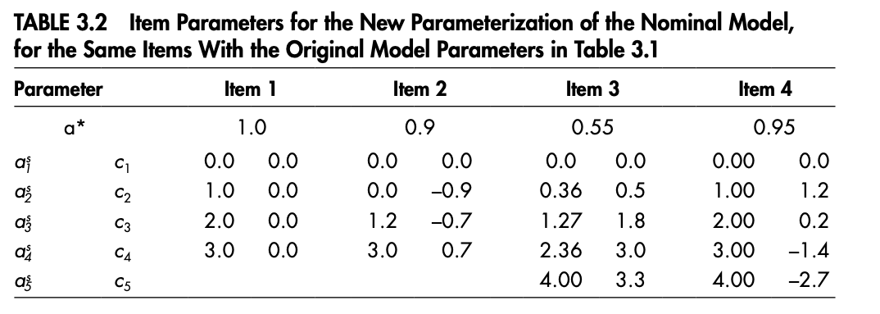
Comparing the two parameterizations
Note that nothing really changed with regard to the (uniterpretable c’s)

Slide 11
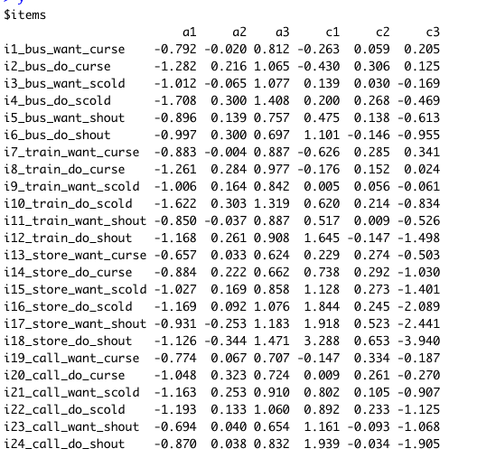
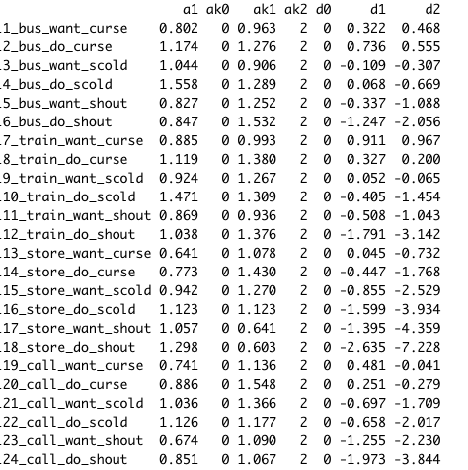
Output in mirt
Notice that all the a’s for our verbal aggression items are in ascending order by no, maybe, yes category—as we’d expect.
coef(nrm, simplify=TRUE,IRTpars=TRUE)
coef(nrm, simplify=TRUE)

Slide 12
General Strategy of using NRM
Fit the model
Look for evidence of category order based on estimates of a’s
Once you know order, compute Andrich thresholds

Slide 13
Thing to Note!
Just because a’s are ordered, does not mean that the thresholds will be!
In fact, they aren’t ordered in any of the examples provided by Bock!

